Slide 1
1.1 Compilers:
A compiler is a program that reads a program written in one language –– the source language –– and translates it into an equivalent program in another language –– the target language

Slide 2
1.1 Compilers:
As an important part of this translation process, the compiler reports to its user the presence of errors in the source program.

Slide 3
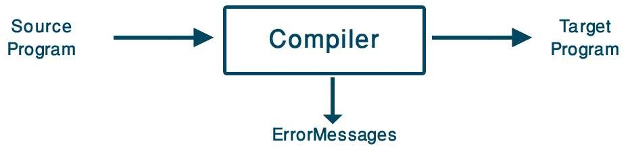
1.1 Compilers:

Slide 4
1.1 Compilers:
At first glance, the variety of compilers may appear overwhelming.
There are thousands of source languages, ranging from traditional programming languages such as FORTRAN and Pascal to specialized languages.

Slide 5
1.1 Compilers:
Target languages are equally as varied;
A target
language programming language,
may be another or the machine
language of any computer.

Slide 6
1.1 Compilers:
Compilers are sometimes classified as:
single-pass
multi-pass
load-and-go
Debugging
optimizing

Slide 7
1.1 Compilers:
The basic tasks that any compiler must perform are essentially the same.
By understanding these
tasks, construct compilers for a wide
we can variety of
source languages and target machines using the same basic techniques.

Slide 8
1.1 Compilers:
Throughout the 1950’s, compilers were considered notoriously difficult programs to write.
The first FORTRAN compiler, for example, took 18 staff-years to implement.

Slide 10
The Analysis-Synthesis Model of Compilation:
There are two parts of compilation:
Analysis
Synthesis

Slide 11
The Analysis-Synthesis Model of Compilation:
The analysis part breaks up the source program into constituent pieces
creates an intermediate representation of the source program.

Slide 12
The Analysis-Synthesis Model of Compilation:
The synthesis
part
constructs
the desired
target program
from the intermediate
representation.

Slide 13



The Analysis-Synthesis Model of Compilation:
source code
Front End
IR
Back End
machine code
errors

Slide 14
The Analysis-Synthesis Model of Compilation:
During analysis, the operations implied by the source program are determined and recorded in a hierarchical structure called a tree.
Often, a special kind of tree called a syntax tree is used.

Slide 15
The Analysis-Synthesis Model of Compilation:
In syntax
tree each node represents an operation and the children of the node
represent the arguments of the operation.
For example, a syntax tree of an assignment statement is shown below.

Slide 16
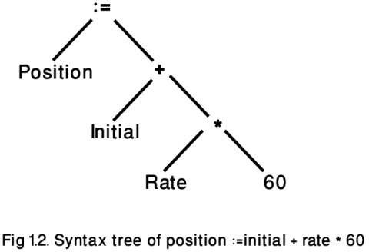
The Analysis-Synthesis Model of Compilation:

Slide 18
Analysis of the Source Program:
In compiling, analysis consists of three phases:
Linear Analysis:
Hierarchical Analysis:
Semantic Analysis:

Slide 19
Analysis of the Source Program:
Linear Analysis:
– In which the stream of characters making up the source program is read from left-to-right and grouped into tokens that are sequences of characters having a collective meaning.

Slide 20
Scanning or Lexical Analysis (Linear Analysis):
In a compiler, linear analysis is called lexical analysis or scanning.
For example, in lexical analysis the characters in the assignment statement
Position: = initial + rate * 60
Would be grouped into the following tokens:

Slide 21
Scanning or Lexical Analysis (Linear Analysis):
The identifier, position.
The assignment symbol :=
The identifier initial.
The plus sign.
The identifier rate.
The multiplication sign.
The number 60.

Slide 22
Scanning or Lexical Analysis (Linear Analysis):
The blanks separating the characters of these tokens would normally be eliminated during the lexical analysis.

Slide 24
Analysis of the Source Program:
Hierarchical Analysis:
– In which characters hierarchically into collective meaning.
or tokens are grouped
nested collections with

Slide 25
Syntax Analysis or Hierarchical Analysis (Parsing):
Hierarchical analysis is called parsing or syntax analysis.
It involves grouping the tokens of the source program into grammatical phases that are used by the compiler to synthesize output.

Slide 26
Syntax Analysis or Hierarchical Analysis (Parsing):
The grammatical phrases of the source program are represented by a parse tree.

Slide 27
Syntax Analysis or Hierarchical Analysis (Parsing):
Assignment Statement
:=
Identifier Position
Expression
+
Expression Identifier Initial
Expression
*
Expression Identifier Rate
Expression Number 60

Slide 28
Syntax Analysis or Hierarchical Analysis (Parsing):
In the expression initial + rate * 60, the phrase rate * 60 is a logical unit because the usual conventions of arithmetic expressions tell us that the multiplication is performed before addition.
Because the expression initial + rate is followed by a *, it is not grouped into a single phrase by itself

Slide 29
Syntax Analysis or Hierarchical Analysis (Parsing):
The hierarchical structure of a program is usually expressed by recursive rules.
For example, we might have the following rules, as part of the definition of expression:

Slide 30
Syntax Analysis or Hierarchical Analysis (Parsing):
Any identifier is an expression.
Any number is an expression
If expression₁ and expression₂ are expressions, then so are
Expression₁ + expression₂
Expression₁ * expression₂
(Expression₁ )

Slide 32
Analysis of the Source Program:
Semantic Analysis:
– In which certain checks are performed to ensure that the components of a program fit together meaningfully.

Slide 33
Semantic Analysis:
The semantic analysis phase checks the source program for semantic errors and gathers type information for the subsequent code- generation phase.

Slide 34
Semantic Analysis:
It uses the hierarchical structure determined by the syntax-analysis phase to identify the operators and operand of expressions and statements.

Slide 35
Semantic Analysis:
An important component of semantic analysis is type checking.
Here are the compiler checks that each operator has operands that are permitted by the source language specification.

Slide 36
Semantic Analysis:
For example,
when a binary arithmetic
operator is applied to an integer and real. In this case, the compiler may need to be converting the integer to a real. As shown in figure given below

Slide 37
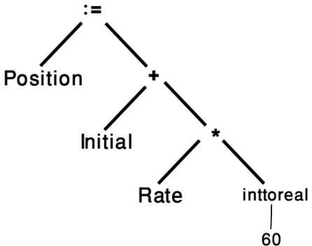
Semantic Analysis:

Slide 39
1.3 The Phases of a Compiler:
A compiler operates in phases.
Each of which transforms the source program from one representation to another.
A typical decomposition of a compiler is shown in fig given below

Slide 40
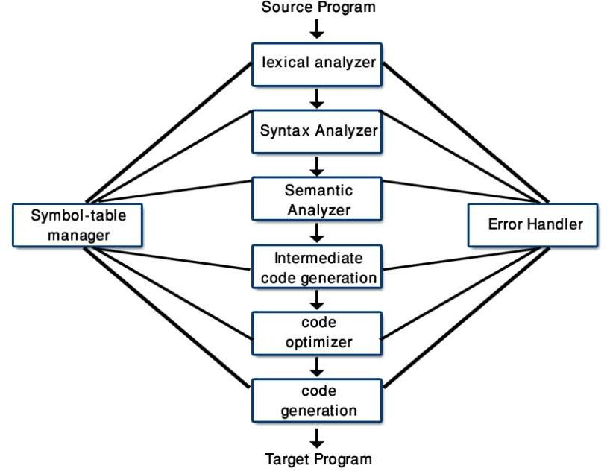
1.3 The Phases of a Compiler:

Slide 41
1.3 The Phases of a Compiler:
Linear Analysis:
– In which the stream of characters making up the source program is read from left-to-right and grouped into tokens that are sequences of characters having a collective meaning.

Slide 42
1.3 The Phases of a Compiler:
In a compiler, linear analysis is called lexical analysis or scanning.
For example, in lexical analysis the characters in the assignment statement
Position: = initial + rate * 60
Would be grouped into the following tokens:

Slide 43
1.3 The Phases of a Compiler:
The identifier, position.
The assignment symbol :=
The identifier initial.
The plus sign.
The identifier rate.
The multiplication sign.
The number 60.

Slide 44
1.3 The Phases of a Compiler:
The blanks separating the characters of these tokens would normally be eliminated during the lexical analysis.

Slide 45
1.3 The Phases of a Compiler:
Hierarchical Analysis:
– In which characters hierarchically into collective meaning.
or tokens are grouped
nested collections with

Slide 46
1.3 The Phases of a Compiler:
Hierarchical analysis is called parsing or syntax analysis.
It involves grouping the tokens of the source program into grammatical phases that are used by the compiler to synthesize output.

Slide 47
1.3 The Phases of a Compiler:
The grammatical phrases of the source program are represented by a parse tree.

Slide 48
1.3 The Phases of a Compiler:
Assignment Statement
:=
Identifier Position
Expression
+
Expression Identifier Initial
Expression
*
Expression Identifier Rate
Expression Number 60

Slide 49
1.3 The Phases of a Compiler:
In the expression initial + rate * 60, the phrase rate * 60 is a logical unit because the usual conventions of arithmetic expressions tell us that the multiplication is performed before addition.
Because the expression initial + rate is followed by a *, it is not grouped into a single phrase by itself

Slide 50
1.3 The Phases of a Compiler:
The hierarchical structure of a program is usually expressed by recursive rules.
For example, we might have the following rules, as part of the definition of expression:

Slide 51
1.3 The Phases of a Compiler:
Any identifier is an expression.
Any number is an expression
If expression₁ and expression₂ are expressions, then so are
Expression₁ + expression₂
Expression₁ * expression₂
(Expression₁ )

Slide 52
1.3 The Phases of a Compiler:
Semantic Analysis:
– In which certain checks are performed to ensure that the components of a program fit together meaningfully.

Slide 53
1.3 The Phases of a Compiler:
The semantic analysis phase checks the source program for semantic errors and gathers type information for the subsequent code- generation phase.

Slide 54
1.3 The Phases of a Compiler:
It uses the hierarchical structure determined by the syntax-analysis phase to identify the operators and operand of expressions and statements.

Slide 55
1.3 The Phases of a Compiler:
An important component of semantic analysis is type checking.
Here are the compiler checks that each operator has operands that are permitted by the source language specification.

Slide 56
1.3 The Phases of a Compiler:
For example,
when a binary arithmetic
operator is applied to an integer and real. In this case, the compiler may need to be converting the integer to a real. As shown in figure given below

Slide 57
1.3 The Phases of a Compiler:

Slide 58
1.3 The Phases of a Compiler:
Symbol Table Management:
An essential function of a compiler is to record the identifiers used in the source program and collect information about various attributes of each identifier.
These attributes may provide information about the storage allocated for an identifier, its type, its scope.

Slide 59
1.3 The Phases of a Compiler:
The symbol table is a data structure containing a record for each identifier with fields for the attributes of the identifier.
When an identifier in the source program is detected by the lexical analyzer, the identifier is entered into the symbol table

Slide 60
1.3 The Phases of a Compiler:
However, the attributes of an identifier cannot normally be determined during lexical analysis.
For example, in a Pascal declaration like
Var position, initial, rate : real;
The type real is not known when position, initial and rate are seen by the lexical analyzer.

Slide 61
1.3 The Phases of a Compiler:
The remaining phases gets information about identifiers into the symbol table and then use this information in various ways.
For example, when doing semantic analysis and intermediate code generation, we need to know what the types of identifiers are, so we can check that the source program uses them in valid ways, and so that we can generate the proper operations on them.

Slide 62
1.3 The Phases of a Compiler:
– The code generator typically enters and uses detailed information about the storage assigned to identifiers.

Slide 64
Error Detection and Reporting:
Each phase can encounter errors.
However, after detecting an error, a phase must somehow deal with that error, so that compilation can proceed, allowing further errors in the source program to be detected.

Slide 65
Error Detection and Reporting:
A compiler that stops when it finds the first error is not as helpful as it could be.
The syntax and semantic analysis phases usually handle a large fraction of the errors detectable by the compiler.

Slide 66
Error Detection and Reporting:
Errors where the token stream violates the structure rules (syntax) of the language are determined by the syntax analysis phase.
The lexical phase can detect errors where the characters remaining in the input do not form any token of the language.

Slide 68
Intermediate Code Generation:
After Syntax and semantic analysis, some compilers generate an explicit intermediate representation of the source program.
We can think of this intermediate representation as a program for an abstract machine.

Slide 69
Intermediate Code Generation:
This intermediate representation should have two important properties;
it should be easy to produce,
easy to translate into the target program.

Slide 70
Intermediate Code Generation:
We consider an intermediate form called “three-address code,”
which is like the assembly language for a machine in which every memory location can act like a register.

Slide 71
Intermediate Code Generation:
Three-address code consists of a sequence of instructions, each of which has at most three operands.
The source program in (1.1) might appear in three-address code as

Slide 72
Intermediate Code Generation:
(1.3)
Temp1 | := | inttoreal (60)
Temp2 | := | id3 * temp1
Temp3 | := | id2 + temp2
id1 :=
temp3

Slide 74
Code Optimization:
The code optimization phase attempts to improve the intermediate code, so that faster- running machine code will result.

Slide 75
Code Optimization:
Some optimizations are trivial.
For example, a natural algorithm generates
the intermediate code (1.3),
using an the tree
instruction for each operator in
representation after semantic analysis, even though there is a better way to perform the same calculation, using the two instructions.

Slide 76
Code Optimization:
(1.4)
Temp1
id :=
:= id3 * 60.0 id2 + temp1
There is nothing wrong with this simple algorithm, since the problem can be fixed during the code-optimization phase.

Slide 77
Code Optimization:
That is, the compiler can deduce that the conversion of 60 from integer to real representation can be done once and for all at compile time, so the inttoreal operation can be eliminated.

Slide 78
Code Optimization:
Besides, temp3 is used only once, to transmit its value to id1. It then becomes safe to substitute id1 for temp3, whereupon the last statement of 1.3 is not needed and the code of 1.4 results.

Slide 80
Code Generation
The final phase of the compiler generation of target code
consisting normally of relocatable code or assembly code.
is the
machine

Slide 81
Code Generation
Memory locations are selected for each of the variables used by the program.
Then, intermediate instructions are each translated into a sequence of machine instructions that perform the same task.
A crucial aspect is the assignment of variables to registers.

Slide 82
Code Generation
For example, using registers 1 and 2, the translation of the code of 1.4 might become
MOVF id3, r2
MULF #60.0, r2
MOVF id2, r1
ADDF r2, r1
MOVF r1, id1

Slide 83
Code Generation
The first and second operands of each instruction specify a source and destination, respectively.
The F in each instruction tells us that instructions deal with floating-point numbers.

Slide 84
Code Generation
This code moves the contents of the address id3 into register 2, and then multiplies it with the real-constant 60.0.
The # signifies that 60.0 is to be treated as a constant.

Slide 85
Code Generation
The third instruction moves id2 into register 1 and adds to it the value previously computed in register 2
Finally, the value in register 1 is moved into the address of id1.

Slide 87
1.4 Cousins of the Compiler:
As we saw in given figure, the input to a compiler may be produced by one or more preprocessors, and further processing of the compiler’s output may be needed before running machine code is obtained.

Slide 88
Skeletal Source Program
Preprocessor
Source program
Compiler
Target assembly program
Assembler
Relocatable machine code
Loader/link-editor
LIBRARY, RELOCATABLE
OBJECT FILES
Absolute machine code
1.3. A LANGUAGE-PROCESSING SYSTEM
88

Slide 89
1.4 Cousins of the Compiler:
Preprocessors:
preprocessors produce input to compilers. They may perform the following functions:
Macro Processing:
File inclusion:
“Rational” Preprocessors:
Language extensions:
108

Slide 90
Preprocessors:
Macro Processing:
– A preprocessor may allow a user to define macros that are shorthand’s for longer constructs.
108

Slide 91
Preprocessors:
File inclusion:
A preprocessor may include header files into the program text.
For example, the C preprocessor causes the contents of the file <global.h> to replace the statement #include <global.h> when it processes a file containing this statement.
108

Slide 92
Preprocessors:
defs.h
main.c
//////
//////
//////
#include “defs.h”
…---…---…---
…---…---…---
…---…---…---
//////
//////
//////
…---…---…---
…---…---…---
…---…---…---
108

Slide 93
Preprocessors:
“Rational” Preprocessors:
– These processors augment older languages with more modern flow-of-control and data-structuring facilities.
108

Slide 94
Preprocessors:
Language extensions:
These processors attempt to add capabilities to the language by what amounts to built-in macros.
For example, the language Equal is a database query language embedded in C. Statements beginning with ## are taken by the preprocessor to be database-access statements, unrelated to C, and are translated into procedure calls on routines that perform the database access.
108

Slide 95
Assemblers:
Some compilers produce assembly code that is passed to an assembler for further processing.
Other compilers
perform
the job
of the
assembler, producing
relocatable
machine
code that can be passed
directly to the
loader/link-editor.
108

Slide 96
Assemblers:
Here we shall review the relationship between assembly and machine code.
108

Slide 97
Assemblers:
In which names are used instead of binary codes for operations, and names are also given to memory addresses.
Assembly code is a mnemonic machine code.
version of
108

Slide 98
Assemblers:
A typical sequence of assembly instructions might be
MOV
ADD
MOV
a , R1 #2 , R1 R1 , b
108

Slide 99
Assemblers:
This code moves the contents of the address a into register 1, then adds the constant 2 to it, reading the contents of register 1 as a fixed- point number, and finally stores the result in the location named by b. thus, it computes b:=a+2.
108

Slide 100
Two-Pass Compiler:
108

Slide 101
Two-Pass Compiler:
The simplest form of assembler makes two passes over the input.
108

Slide 102
Two-Pass Compiler:
in the first pass, all the identifiers that denote storage locations are found and stored in a symbol table
Identifiers are assigned storage locations as they are encountered for the first time, so after reading 1.6, for example, the symbol table might contain the entries shown in given below.
108

Slide 103
Two-Pass Compiler:
MOV a , R1 ADD #2 , R1 MOV R1 , b
Identifiers
a b
Address 0
4
108

Slide 104
Two-Pass Compiler:
In the second pass, the assembler scans the input again.
This time, it translates each operation code into the sequence of bits representing that operation in machine language.
₂nd
The output of the pass is usually
relocatable machine code.
108

Slide 105
Loaders and Link-Editors:
usually, a program called a loader performs the two functions of loading and link-editing.
108

Slide 106
Loaders and Link-Editors:
The process of loading consists of taking relocatable machine code, altering the relocatable addresses, and placing the altered instructions and data in memory at the proper location.
108

Slide 107
Loaders and Link-Editors:
The link-editor allows us to make a single program from several files of relocatable machine code.
108

Slide 108
108

Slide 109
1.5
The Grouping of Phases:
108

Slide 110
Front and Back Ends:
The phases are collected into a front end and a back end.
The front end consists of those phases that depend primarily on the source language and are largely independent of the target machine.
108

Slide 111
Front and Back Ends:
These normally include lexical and syntactic analysis, the creating of the symbol table, semantic analysis, and the generation of intermediate code.
A certain among of code optimization can be done by the front end as well.
108

Slide 112
Front and Back Ends:
The front end also includes the error handling that goes along with each of these phases.
108

Slide 113
Front and Back Ends:
The back end includes those portions of the compiler that depend on the target machine.
And generally, these portions do not depend on the source language, depend on just the intermediate language.
108

Slide 114
Front and Back Ends:
In the back end, we find aspects of the code optimization phase, and we find code generation, along with the necessary error handling and symbol table operations.
108

Slide 115
108

Slide 116
Passes:
108

Slide 117
108

Slide 118
108

Slide 119
Compiler-Construction Tools:
The compiler writer, like any programmer, can profitably use tools such as
Debuggers,
Version managers,
Profilers and so on.
108

Slide 120
Compiler-Construction Tools:
In addition to these software-development tools, other more specialized tools have been developed for helping implement various phases of a compiler.
108

Slide 121
Compiler-Construction Tools:
Shortly after the first compilers were written, systems to help with the compiler-writing process appeared.
These systems have often been referred to as
Compiler-compilers,
Compiler-generators,
Or Translator-writing systems.
108

Slide 122
Compiler-Construction Tools:
Some general tools have been created for the automatic design of specific compiler components.
These tools use specialized languages for specifying and implementing the component, and many use algorithms that are quite sophisticated.
108

Slide 123
Compiler-Construction Tools:
The most successful tools are those that hide the details of the generation algorithm and produce components that can be easily integrated into the remainder of a compiler.
108

Slide 124
Compiler-Construction Tools:
The following is a list of some useful compiler- construction tools:
Parser generators
Scanner generators
Syntax directed translation engines
Automatic code generators
Data-flow engines
108

Slide 125
Compiler-Construction Tools:
Parser generators
These produce syntax analyzers, normally from input that is based on a context-free grammar.
In early compilers, syntax analysis consumed not only a large fraction of the running time of a compiler, but a large fraction of the intellectual effort of writing a compiler.
This phase is considered one of the easiest to implement.
108

Slide 126
Compiler-Construction Tools:
Scanner generators:
These tools automatically generate lexical analyzers, normally from a specification based on regular expressions.
The basic organization of the resulting lexical analyzer is in effect a finite automaton.
108

Slide 127
Compiler-Construction Tools:
Syntax directed translation engines:
These produce collections of routines that walk the parse tree, generating intermediate code.
The basic idea is that one or more “translations” are associated with each node of the parse tree, and each translation is defined in terms of translations at its neighbor nodes in the tree.
108

Slide 128
Compiler-Construction Tools:
Automatic code generators:
– Such a tool takes a collection of rules that define the translation of each operation of the intermediate language into the machine language for the target machine.
108

Slide 129
Data-flow engines:
– Much of the information needed to perform good code optimization involves “data-flow analysis,” the gathering of information how values are transmitted from one part of a program to each other part.
108

